Slide 1
Propositional Logic
Dr. Ramalingaswamy Cheruku

Slide 2
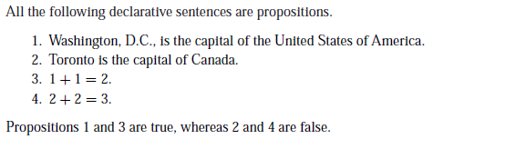
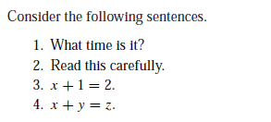
What is proposition ?
Basic building blocks of logic—propositions. A proposition is a declarative sentence (that is, a sentence that declares a fact) that is either true or false, but not both.

Slide 3
Propositional Variable
We use letters to denote propositional variables (or statement variables), that is, variables that represent propositions, just as letters are used to denote numerical variables.
EX: propositional variables are p, q, r, s, . . .

Slide 5
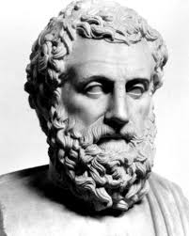
Propositional Logic
The area of logic that deals with propositions is called the propositional calculus or propositional logic.
It was first developed systematically by the Greek philosopher Aristotle.
Many mathematical statements are constructed by combining one or more propositions. New propositions, called compound propositions, are formed from existing propositions using logical operators.

Slide 6
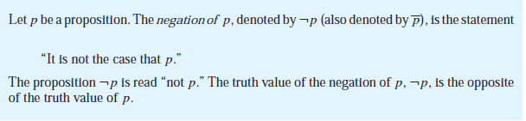
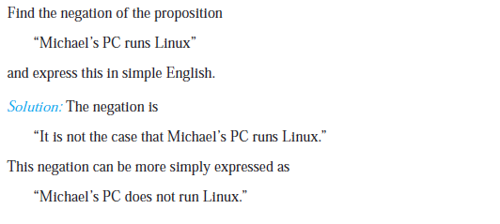
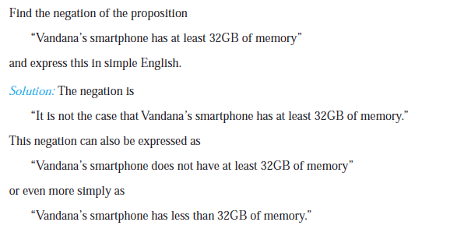
Negation (~)

Slide 7
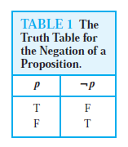
Negation Truth Table

Slide 9
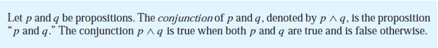
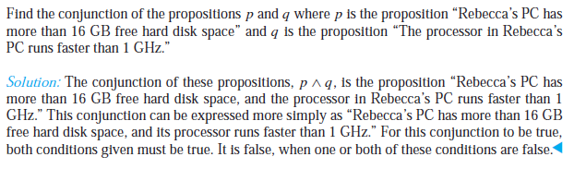
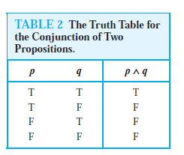
Conjunction (^)

Slide 10
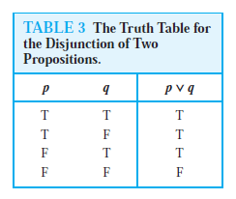
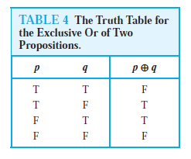
Disjunction (inclusive or)
Connective or in a disjunction corresponds to one of the two ways the word or is used in English, namely, as an inclusive or.
A disjunction is true when at least one of the two propositions is true. For instance, the inclusive or is being used in the statement.
Here, we mean that students who have taken both calculus and computer science can take the class, as well as the students who have taken only one of the two subjects.
exclusive or : “Students who have taken calculus or computer science, but not both, can enroll in this class.”
Here, we mean that students who have taken both calculus and a computer science course cannot take the class. Only those who have taken exactly one of the two courses can take the class.

Slide 12
The disjunction of p and q, p ∨ q, is the proposition
“Rebecca’s PC has at least 16 GB free hard disk space, or the processor in Rebecca’s PC runs faster than 1 GHz.”
This proposition is true when Rebecca’s PC has at least 16 GB free hard disk space, when the PC’s processor runs faster than 1 GHz, and when both conditions are true. It is false when both of these conditions are false, that is, when Rebecca’s PC has less than 16 GB free hard disk space and the processor in her PC runs at 1 GHz or slower

Slide 13
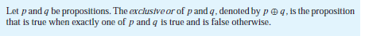
Exclusive or

Slide 14
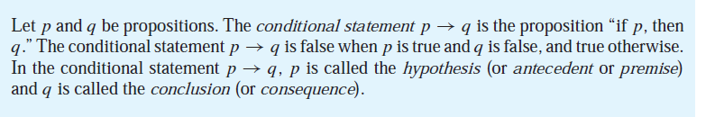
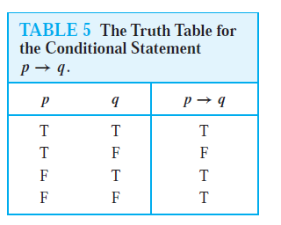
Conditional statements
The statement p → q is called a conditional statement because p → q asserts that q is true on the condition that p holds. A conditional statement is also called an implication.
Note that the statement p → q is true when both p and q are true and when p is false (no matter what truth value q has)

Slide 16
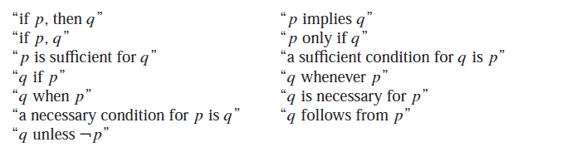
Because conditional statements play such an essential role in mathematical reasoning, a variety of terminology is used to express p → q.

Slide 18
Examples:
p : “Maria learns discrete mathematics”
q: “Maria will find a good job.”
p → q as a statement in English
“If Maria learns discrete mathematics, then she will find a good job.”
“Maria will find a good job when she learns discrete mathematics.”
“For Maria to get a good job, it is sufficient for her to learn discrete mathematics.”

Slide 19
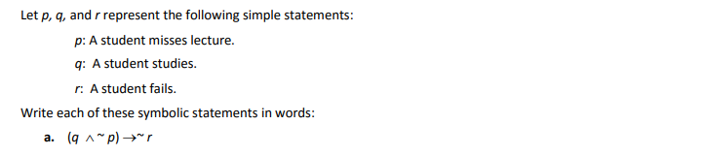
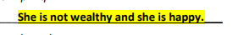
Examples

Slide 21
Important
Note that the way we have defined conditional statements is more general than the meaning attached to such statements in the English language.
For instance, the conditional statement “If it is sunny, then we will go to the beach.” are statements used in normal language where there is a relationship between the hypothesis and the conclusion.
“If Juan has a smartphone, then 2 + 3 = 5” is true from the definition of a conditional statement, because its conclusion is true. (The truth value of the hypothesis does not matter then.)
“If Juan has a smartphone, then 2 + 3 = 6” is true if Juan does not have a smartphone, even though 2 + 3 = 6 is false.
We would not use these last two conditional statements in natural language, because there is no relationship between the hypothesis and the conclusion in either statement.
In mathematical reasoning, we consider conditional statements of a more general sort than we use in English.
The mathematical concept of a conditional statement is independent of a cause-and effect relationship between hypothesis and conclusion.
Propositional language is an artificial language; we only parallel English usage to make it easy to use and remember

Slide 23
CONVERSE, CONTRAPOSITIVE, AND INVERSE
We can form some new conditional statements starting with a conditional statement p → q.
The converse of p → q is the proposition q → p.
The contrapositive of p → q is the proposition ￢q →￢p.
The inverse of p → q is the proposition ￢p →￢q .
Imp: contrapositive always has the same truth value as p → q.

Slide 25
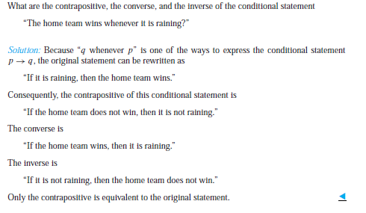
Example:

Slide 26
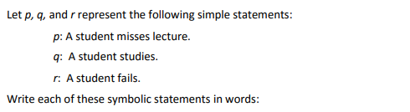
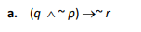
Examples

Slide 28
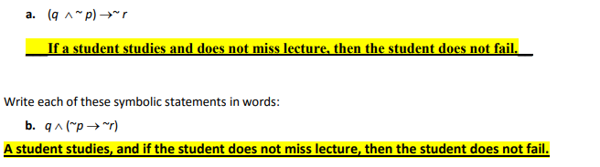

Slide 29
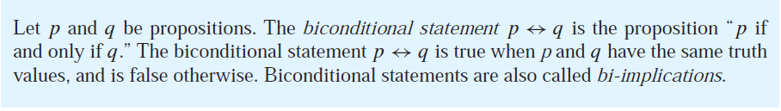
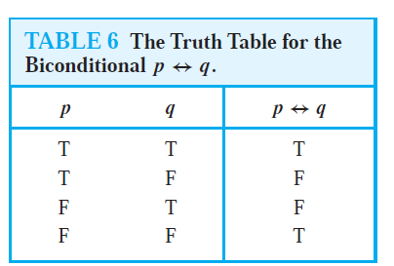
Biconditionals
There are some other common ways to express p ↔ q:
“p is necessary and sufficient for q”
“if p then q, and conversely”
“p iff q.”
p ↔ q uses the abbreviation “iff” for “if and only if.”
Note that p ↔ q has exactly the same truth value as (p → q) ∧ (q → p).

Slide 30
Tautology, contradiction, contingency
Tautology: A propositional function is always true
contradiction: A propositional function is always false
Contingency: A propositional function neither Tautology nor contradiction

Slide 31
Tautology implication (=>)
“P tautologically implies Q” or p=>q, if q is true whenever p is true
If p=>q then p->q is a tautology
Examples: p=> (p or q)
(p^ q) => (p<->q)
(p^q) => q

Slide 32
Equivalence (⬄)
If p and q are any two propositions are p⬄q if p and q have same truth values
Ex: p->q ⬄( ~p or q)

